Slide 1
Competitive Analysis Portfolio
Shirley Lim
COGS 187A
HW#1

Slide 2
About myself
Keywords:
Linguist/ culture, minimalistic, child-at-heart
Dreamer
Runner/ one who perseveres
Notes:
Here are a few keywords or possible ideas I am interested in showcasing about myself. I am very interested in learning about languages and have studied formally during high school and college. Because of immigrant parents, I am able to speak several dialects of Chinese. At first I resisted learning English, but it really opened up a new world of English speakers.
I’m a dreamer, often more optimistic than I should be. I grew up in a struggling working family, learning an early age on how to be independent. While my friends enjoyed family trips, I never went on one (until last year with a family that isn’t mine). I’ve always wanted to travel and have experiences and just be happy. My optimistic attitude is paired with the innocence of a child.
I love simplicity and take on a minimalistic approach. My dreams is one day provide just enough to be self-sufficient and enjoy life as it comes.

Slide 3
Starting off..
The next few schemes are personal portfolios of my friends.
In the reading, “How to Steal Like an Artist”, the author penned various anecdotes, such as “Nothing is original” and “Do good work and share with people”, I hope by comparing their personas that I know on personal level and one they want to be known on the web professionally.
Notes:
Note to TA: The first few portfolios are classmates/ friends of mine. Most of them currently work in design and graphic arts related fields, so I hope it’s interesting to provide details about them from a personal note, but at the same time provide an analysis about their professional profile. The latter half are primarily profiles I found from various blogs entries of “exceptional” design portfolios and templates. These latter ones often use a hybrid of the 10 generic templates popular with today’s design industry.
I really found the “How to Steal Like an Artist” piece interesting. I would love to incorporate wisdoms and anecdotes I’ve learned over the course of college in my future portfolio.

Slide 4
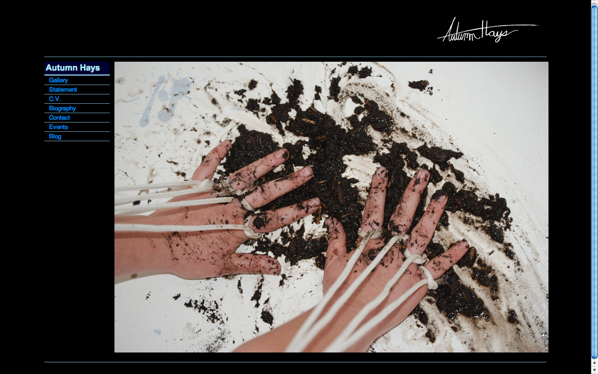
#1
Notes:
Site Name: Autumn Hays
Site URL: http://www.autumnhays.com/
Date Looked at: 1/19/2012 (last updated)
Layout: Featured Photo or Fixed Sidebar
Brand
There are several ideas about Ms. Hays displays in her portfolio. Her cover picture (seen above) conveys that she is a person who best uses her hands (and doesn’t mind getting her hands or nails dirty). It seems natural to some degree until you notices the individual strings tied to 8 of her digits. It seems like she is constricted in some ways. Without additional knowledge, it almost seems like she is being puppeteered by an unknown source. As we look more into her profile [statement, biography and gallery]. She is also interested in using her art to discuss issues like “social injustice, cognitive dissonance and decline of human faith”. This may explain the darker background. Most websites I note usually have a white background to bring in the focus. Her website also seems more authentic with her signature/ logo in the top right corner.
Functionality
2. I think it’s simple and functional. The left column highlights her name and links to her work. I noted that she doesn’t have a link for “main” (or home), but noticed by playing with her site that all her other linked pages do. She makes use of a gallery display to highlight various shows she has done in her time in San Diego and Chicago. The remaining links provide information about her that doesn’t overwhelm her main page. She has additions links that discussed a statement, which I found really interesting. Additionally it lists her impressive background, CV and contact information.
Interactivity
3. Her pages takes on a simple ‘click’ and transition. I appreciate that she doesn’t use methods or medias that may slow or make it difficult to navigate. I found that I had no troubles locating any of her links and they saw that in her gallery, she had previews of albums of photos and this makes it easier on the user who has to wait otherwise for original sized pictures to load. Also if she didn’t opt for the smaller screen shots, she would have to be choosier about what best reflects her.
Navigation
4. Navigation was not difficult because she made use of the main panel. There was hardly any need to use a scroll bar on most pages, which definitely does eliminate user confusion on navigating between various pages. I think it’s great because her website is most likely cross-platform compatible.

Slide 5
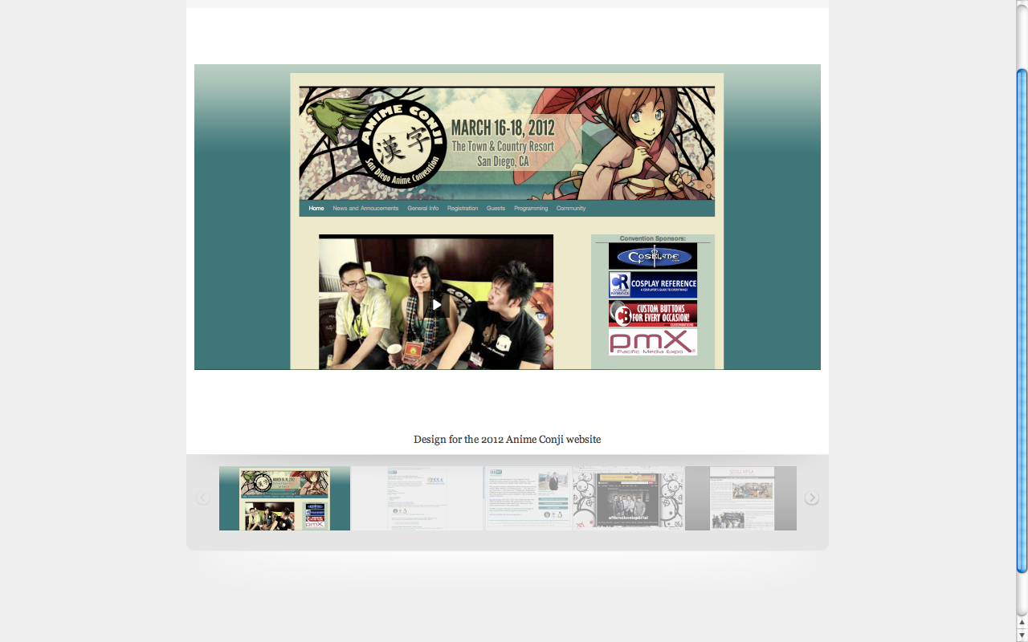
Notes:
Site Name: Web Design for San Diego Anime Convention (Anime Conji)
Site URL: http://myleneerpelo.carbonmade.com/projects/2053044#1
Date Looked at: Date Looked at: 1/19/2012 (last updated)
Layout: 3 Boxes
Brand
This is the official page for the San Diego Anime Convention of 2012. According to their Sponsors (bottom right box), this is a convention for artists, Anime enthusiasts and Cosplay (costumes) events. The banner features a beautiful girl with an umbrella to shade her from the beautiful day. The cherry blossoms are blowing behind. The banner also communicates that the convention is held in Town and Country Resort (sounds elegant). The Japanese are known to be quiet beauties with grace and calm allure.
Functionality
2. The functionality to this site is unfortunately unavailable. This seems to be a screen shot of the main page. The supposed functionality should communicate news, general information, ticket or registration process, the programming and the targeted people who will be attending. Luckily she does communicate this in the banner (which I assume is clickable), the simple ‘home’ link on the top left assures me that it shouldn’t be difficult to return to the home page.
Interactivity
3. I think most of the interactivity would happen between the links and the video in the bottom left corner. The 3 people picture may be staff members or people of importance to this conference. The sponsors are conveniently placed on the right side in a non-obtrusive manner. The larger banner boxes per sponsor seems to suggest that these are clickable links that lead to the to Sponsors’ main sites.
Navigation
4. I don’t think navigation shouldn’t be too difficult as it is part of a 3 box layout. The small number of links don’t provide many outside options. One thing that can possibly be useful is an address or contact information that placed on the main page describing more of the location or hosts.

Slide 6
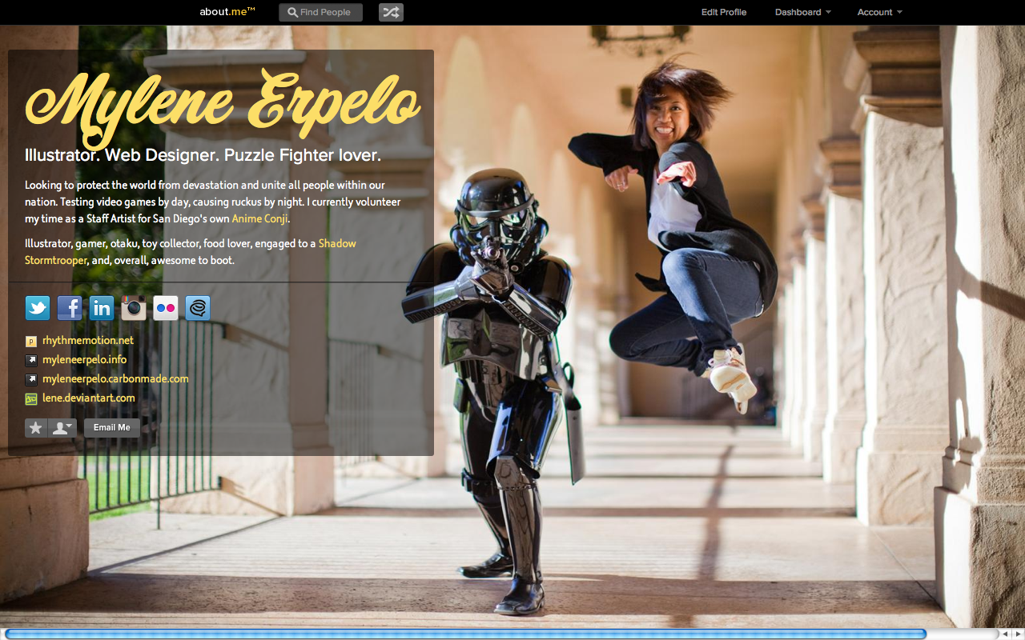
Notes:
Site Name: About Me: Mylene
Site URL: http://about.me/mylene
Date Looked at: Date Looked at: 1/19/2012 (last updated)
Layout: Featured Photo
Brand
This is the 2nd of 3 of Mylene Erpelo’s various portfolio layouts (slides 5-7). I think this one best describes the ‘feature photo’. Judging by the picture she uses as her background, this give us more of an insight about her playful nature. Here, she is seen performing a kick mid-air next to a posing (and possibly violent) Stormtrooper. Her background is a backdrop with many columns and flying buttresses. In a short description, she emphasizes that she’s an illustrator and web designer and who’s much interested in puzzles. In a heroic descript, we get that she resides in SD as local artist.
Functionality
2. The site is simple. She has one left semi-transparent box that lists her contact information. She makes use of the colors yellow and white in a light black background. The black isn’t completely solid so you can see the the transparency, which would have covered a gate. I think this would serve as a “kick-ass” online business card. Her name is clearly displayed. You can see her character descriptions and her contacts and high knowledge of social media sites. She doesn’t look boring (not by any means).
Interactivity/ Navigation
3. There shouldn’t be too much thought into going into navigating this page. I’m really starting this idea where a scroll bar is not needed. I like this idea as it doesn’t require too much resizing if you had to switch platforms. Her links are neatly organized in ways you can contact her. The top bar may not be as interactive because it doesn’t do too much for the site.

Slide 7
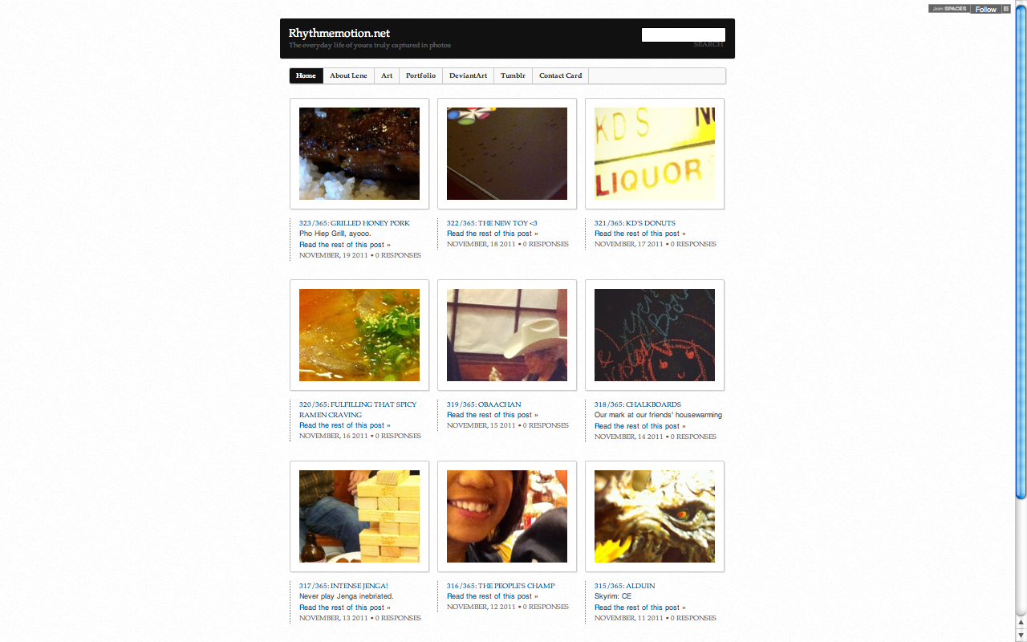
Notes:
Site Name: Rhythm emotion.net: The Everyday Life of Yours Truly Captured in Pictures
Site URL: http://rhythmemotion.net/
Date Looked at: Date Looked at: 1/19/2012 (last updated)
Layout: Headline and Gallery
Brand
I think her name and title captures the essence of this portfolio. She uses photos to tell stories about her various interests and other things that go on with life. Few of them are mundane and others tell interesting stories, such as “don’t play Jenga inebriated”. She has a great sense of humor that I get from her easy going smile (as seen the the 8th picture or #316).
Functionality
2. I think it’s a simple way for her to highlight her most memorable photos. The clean white interface focuses me on the photos that appear on each page. I note that her site doesn’t require the need of scrolling too much. It has a certain organization that structures the random assortment of moments she calls life.
Interactivity/ Navigation
3. When I’m playing around her site, I checked the functionality of all her links on the top. I’m not sure if I understand how to make use of the search bar she has on top. Her smaller banner that doesn’t seem very aligned (maybe I’m just being picky), the empty space at the end of the banner can also be eliminated and perhaps either elongated or centered. When I stroll to the bottom of the page, I notice that her main page is 1 of 48! In addition to her info links in the 2nd banner, she uses a contrasting black background to give the user a simple description about herself. It also allows the option to subscribe to her and a list of her archives by year.
I also notice that she allows visitors to comment on her photos, which has me believing that this is more informal. I like the contact page. It really does seem like her smile and the easy-goingness is emphasized.

Slide 8
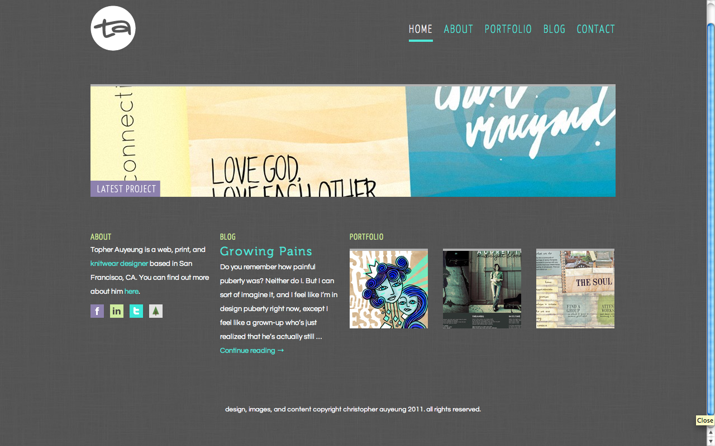
Notes:
Site Name: Topher Auyeung
Site URL: http://topherky.com/
Date Looked at: 1/19/2012 (last updated)
Layout: 5 Boxes
Brand
Chris is a warm and devout Christian. He seems to be centered individual that jumped from various studies before deciding that he was more interested in user interfaces and knitting warm attire. Using various medias, his artwork and designs are different from the others so far. There is one picture of him (or anyone else). Instead he seems to focus more on the words of God. I would say this best describes his portfolio, it’s also rather interesting that he placed a link for a blog entry on “growing pains (puberty)” on the main page. The other three boxes gives you a snapshot of his other projects.
Functionality, Interactivity, Navigation
2. His layout is simple, though redundant at time. I’m not sure if I would like having a top banner, but also repeat some of the functions in the “about”, “blog” and “portfolio”. The advantage of this does allow you to see a preview of his work before you click on the respective links. Another plus is the easy accessibility to 3 of the pages (about, portfolio and blog). On the other hand, the “contact” and “home” are only found on the top right corner. Also, his logo on the top left (TA) also serves a home button.

Slide 9
The next few slides are ones I came across while researching portfolio layouts…

Slide 10
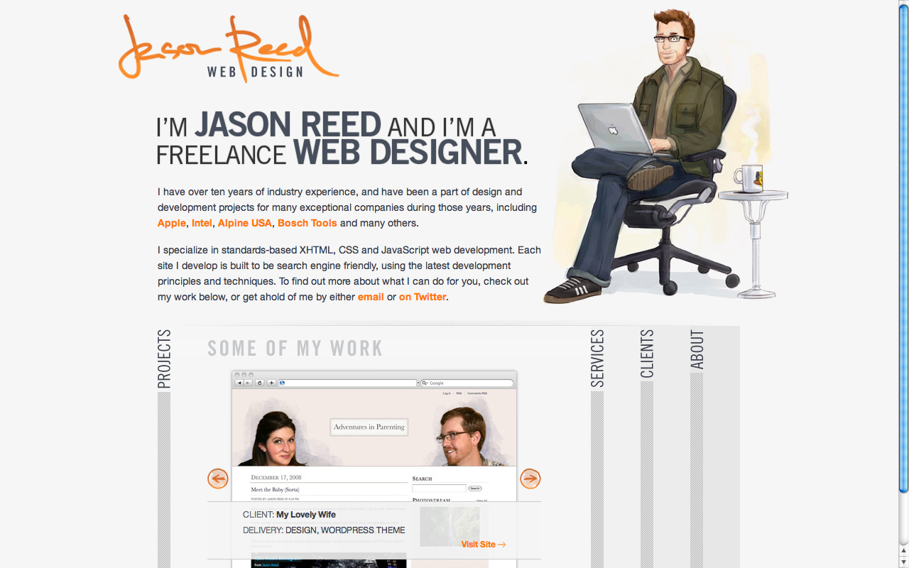
Notes:
Site Name: Jason Reed, Web Design
Site URL: http://www.jasonreedwebdesign.com/
Date Looked at: 1/19/2012 (last updated)
Layout: 3D Screenshot / 5 Boxes
Brand
The caricature (though not heavily exaggerated) despites Mr. Reed as a web-friendly designer as an everyday guy. He’s in casual attire, comfortable shoes and ergonomic workchair with a faithful coffee on his MacBook. His autograph (which also functions as his logo) is elegant and slants slightly to the left. This is supposely a mark of a creative person.
Functionality, Interactivity, Navigation
2. His blurb to the left of his picture stresses his name and his occupation. I do like that he has an impressive resume, such as clients from Apple, Intel and Bosch Tools. He conveniently links you to the home pages of this companies, but that confuses me. Does that mean he was a designer for these specific pages? I think what would be more impressive would be the work he completed for these companies. I really like the idea of the sliding pages. They’re fairly close to 3D, and the arrows allows him to post related media under one tab. From this he can showcase some of his work and include a professional webshot of his wife (for a webpage he created for her). The tabs also communicates which medias he uses to create his web designs and the last two tab tells the user about himself and the clientel he serves.
In a minimal but effective way, he has a banner on the very bottom with ways to link up to him.

Slide 11
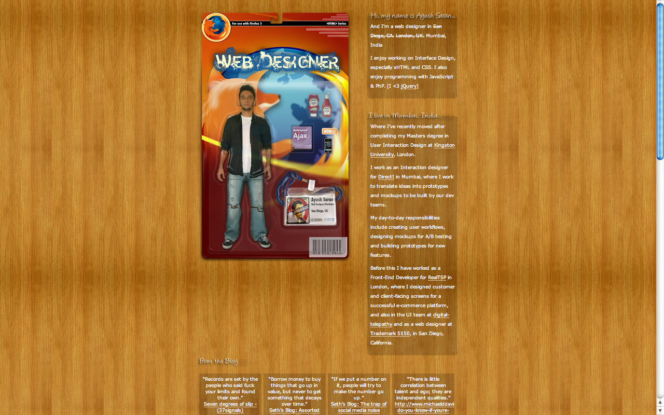
Notes:
Site Name: Ayush Saran, Web Designer
Site URL: http://www.ayushsaran.com/
Date Looked at: 1/19/2012 (last updated)
Layout: Power Grid
Brand
Judging by the image, we should see him as an action figure complete with spiky hair and comes with Ketchup, Ajax book, an Iphone and a badge. According to the packaging, it seems that he develops most in HTML on the Mozilla platform.
Functionality, Interactivity, Navigation
2. This is one of the longer portfolios I analyzed whom had to make use of his scrollbar. The polished vinyl background seems to indicate a clean and robust surface. While the portfolio is straightforward, I think he should have made better use of the work space. The thin layout (which is approximately 1/3 of the total workspace) creates a sense of clutter from the seemingly long descriptions of his background and other projects. He also lists his blogs and contact info in horizontal block scheme.
The product looks polished, but doesn’t make use of the space efficiently. The scrollbar elicit curiosity why his page looks so long.

Slide 12
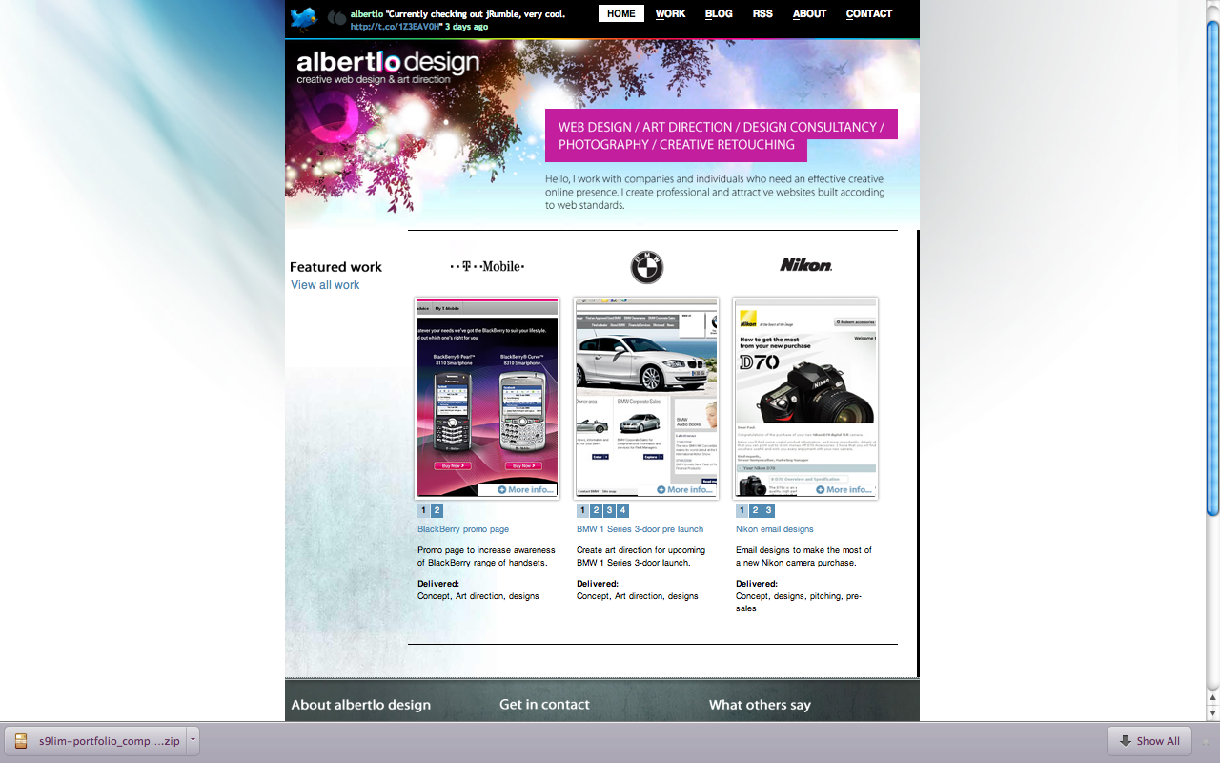
Notes:
Site Name: Albert Lo Design, Creative Web Design & Art Direction
Site URL: http://www.albertlo.com/
Date Looked at: Date Looked at: 1/19/2012 (last updated)
Layout: Fixed Side Bar
Brand
I think out of all the websites I looked at, this one was the most aesthetically pleasing. I like the calm blend of cloud whites, pinks, blues and purples (my favorite colors).
Functionality, Interaction, Navigation
His website reads like the functionality of a newspaper. On top, you see a banner in small print with a home button, blog, work, RSS subscription and
contact information. I think it’s a nice layout. Nothing too overwhelming, but does have more print than the other profiles. I liked how he placed the function
and purpose of the his portfolio in magenta/purple. He also displays 3 projects he has been associated with. Most of these are concept pages (which I’m
not sure what that means). He does incorporate some 3d transitions, though I’m not sure why he would place a panel with a black X to mark the end of
the pages (Maybe he wants you to read it like a brochure?). The brands that he features are well known companies worldwide and know for luxury or
good living.
In his fixed panel, he aligned two options for the user to look at his portfolio/works against the other banners. When I did checked out his other work, they
were all impressive though a bit outdated now. His last references were from 2008 and can probably use an update. He does may use of social media
and blogs on a regular basis. His contact info (similar to the fixed scheme of #13) is also placed on the bottom with an info blurb, contacts and
testimonials.

Slide 13
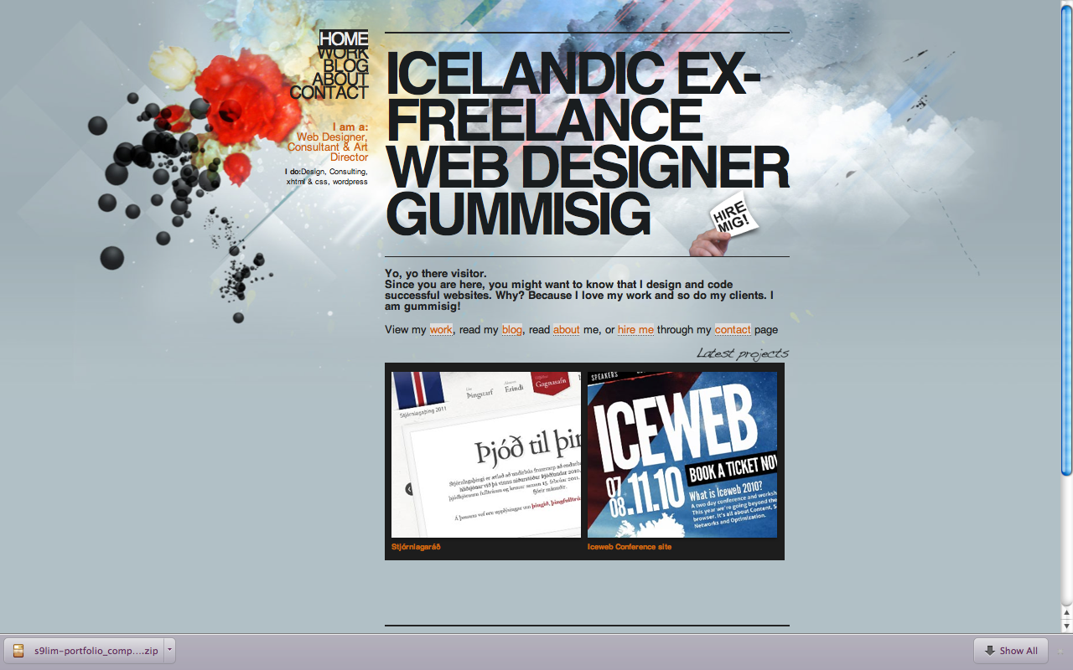
Notes:
Site Name: Icelandic Ex-Freelance Web Designer Gummisig
Site URL: http://www.gummisig.com/
Date Looked at: 1/19/2012 (last updated)
Layout: Fixed Sidebar
Brand
I feel that Gummisig conveys a free-falling (carefree) minimalistic approach to web designing is just simply gorgeous. The blend of colors just underneath the fixed sidebar and transparent banner almost looks like it was colored in. It also felt like there was this heavenly light that called for his artistic knowledge.
Functionality, Interactivity, Navigation
2. It seemed like a very minimalistic approach (which I do like), very clean layout. The banners for his about and contact information is on the side, in the center of the page (looks like it was part of a descriptions). He has a panel that shows you his 2 latest projects from 2 years ago (probably explains why he’s an ex-freelancer now). And while his page appeared longer than the others (just barely!). His contact information, references, updates and local social media outlets are clearly displayed on the bottom of the page. If you choose not to scroll all the way down, his contact info is also found the ‘contact’. I notice that he also employed the bottom of the screen to be fixed (just like the sidebar). It may be smart because his contacts are so readily available.
He also notes that he’s an XHTML and CSS expert, so I hope to emulate and adopt some of his techniques as part of my own. His ‘work’ page also displayed additional projects and I learned through his contacts that he is a well received designer. It’s no wonder because multiple portfolio design blogs referenced him.

Slide 14
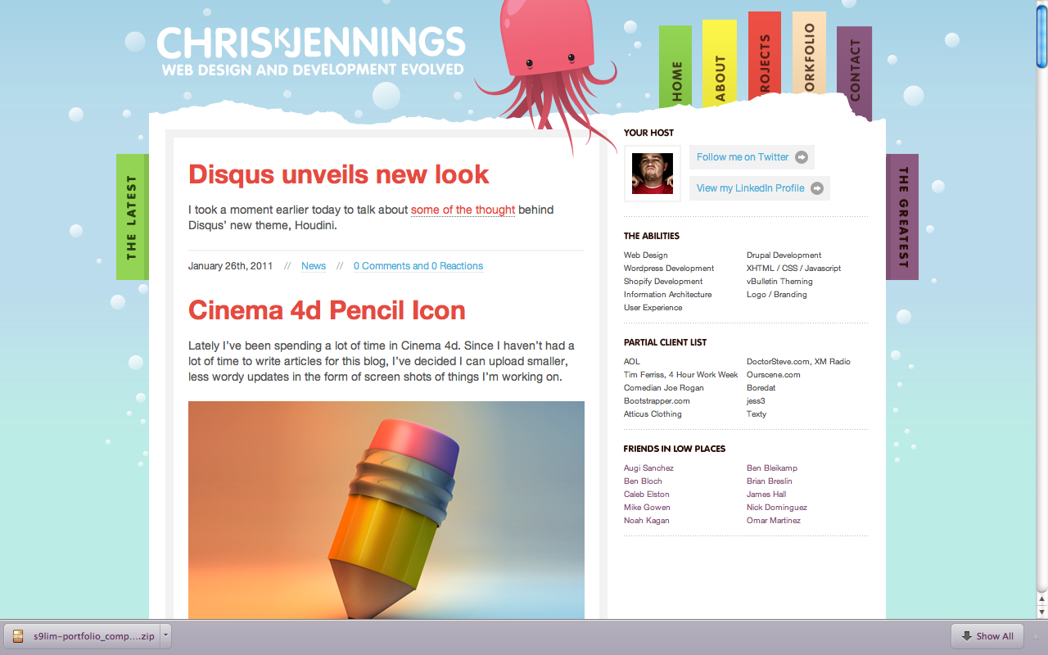
Notes:
Site Name: Chris K. Jennings- Web Design and Development Evolved
Site URL: http://chrisjennings.com/
Date Looked at: 1/19/2012 (last updated)
Layout: Fixed Sidebar
Brand
The layout resembles a page from my planner/datebook. The colors and orientation gives the visitor a calm feeling
Functionality, Interactivity, Navigation
You can check out the latest going on the left panel, whereas the designer places a fixed column on the right. This is interesting because slides #12-13 and 6 makes use of the side bar on the left. Navigation is quite simple as his available tabs are strategically placed on top with his contact info. There is a little animation going on when the mouse is place over one of the colored tabs (they pop up and magnify the selected tab). The rest of his page is set up similarly like a blog. I like the simplicity of this layout, but feel that the projects should be placed on the main page.

